Slide 1
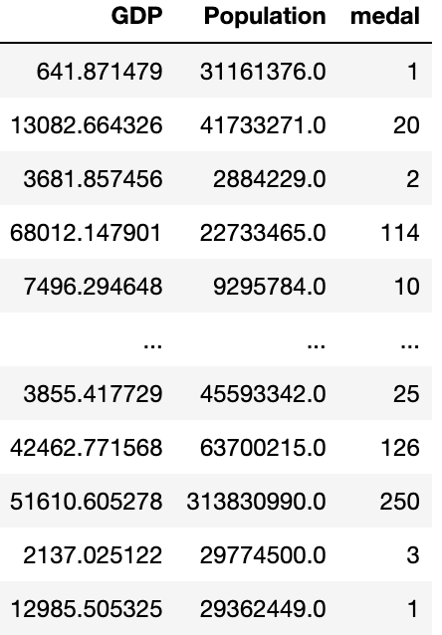
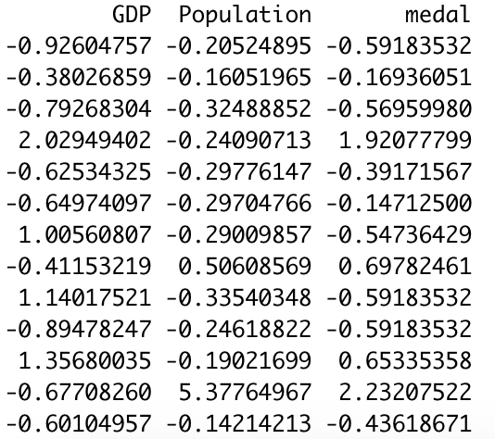

Making the data confess
（1）data
data: the GDP, population of each country in 2012, and the total number of medals won that year.
Data processing: standardized the data to eliminate the influence of different unit variables.
after scale
raw data

Slide 2
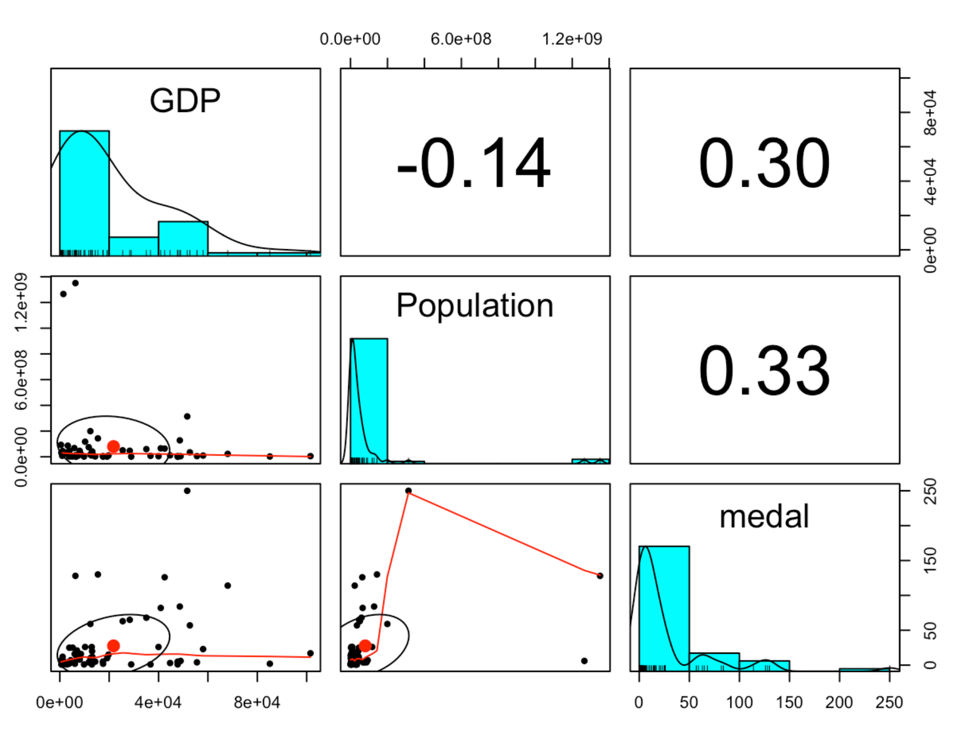
（2）Linear correlation
This is a correlation graph. From the graph, we can see that when GDP and population increase, medals will also increase. They have a small amount of linear correlation.
Correlation scatter plot and correlation coefficient

Slide 3


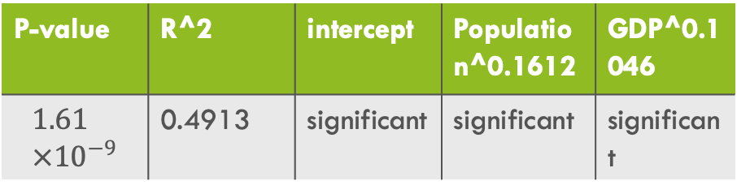
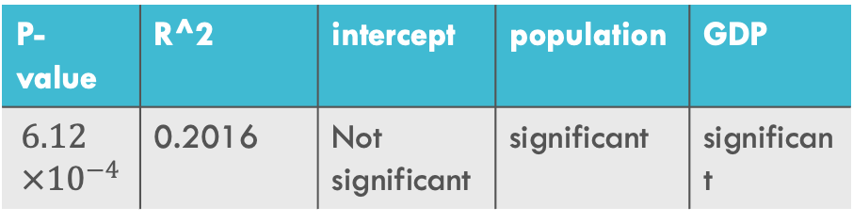
（3）Model and improvement
Linear regression model
Nonlinear regression model
P-value | R^2 | intercept | population | GDP
$$6.12×{10}^{−4}$$ | 0.2016 | Not significant | significant | significant
P-value | R^2 | intercept | Population^0.1612 | GDP^0.1046
$$1.61×{10}^{−9}$$ | 0.4913 | significant | significant | significant
population
$${population}^{0.1612}$$
GDP
$${GDP}^{0.1046}$$
R^2
intercept

Slide 4
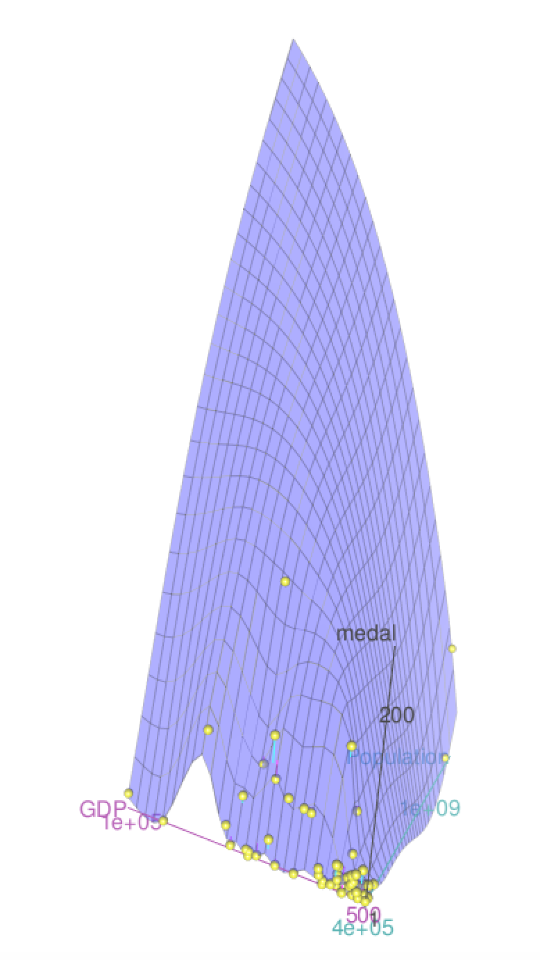
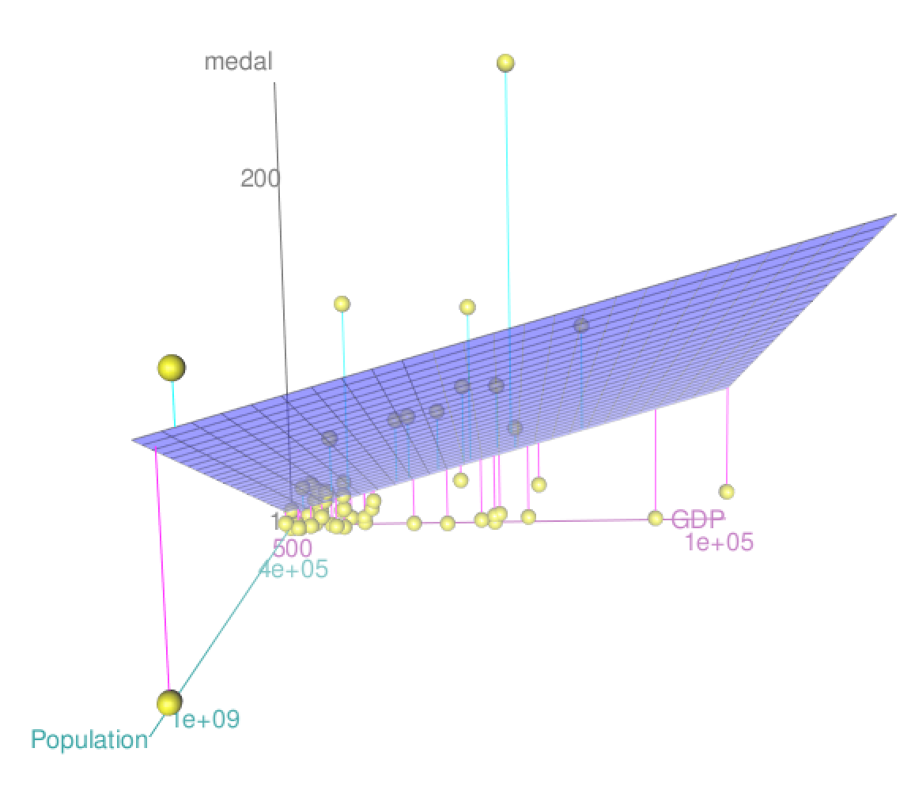

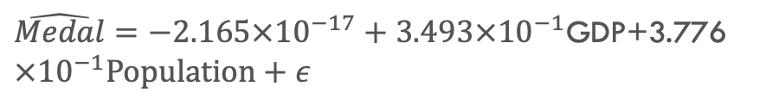
（4）Conclusion and explanation
Linear regression model
Nonlinear regression model
$\hat{Medal}=−2.165×{10}^{−17}+3.493×{10}^{−1}$GDP+3.776 $×{10}^{−1}Population+ε$
$\hat{Medal}=−235.8594+6.5721×{Population}^{0.16127}$+60.9428 $×{GDP}^{0.10468}+ε$

